Slide 1


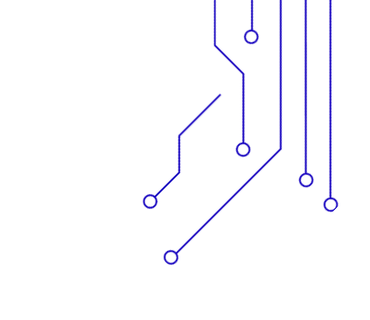
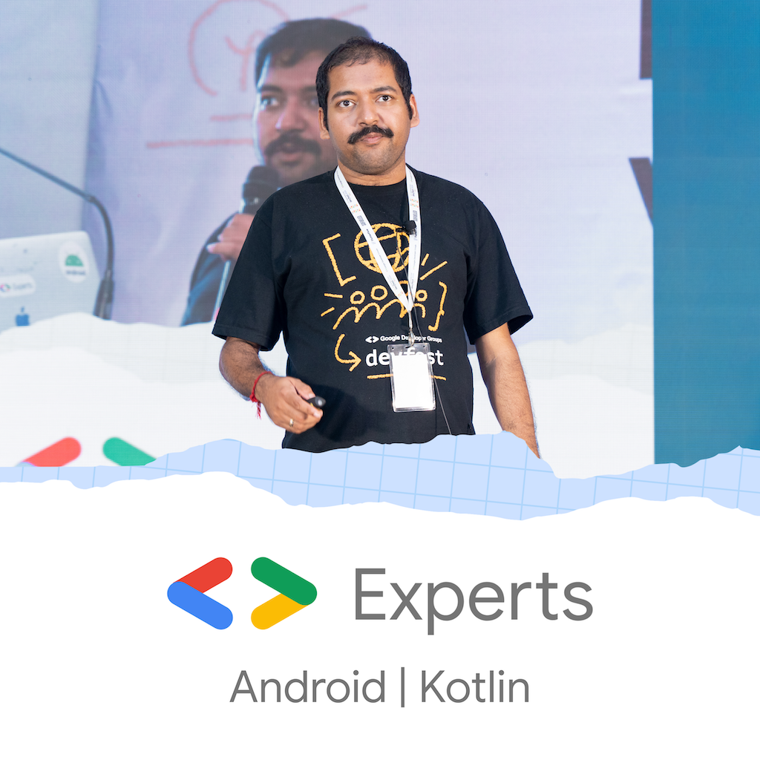
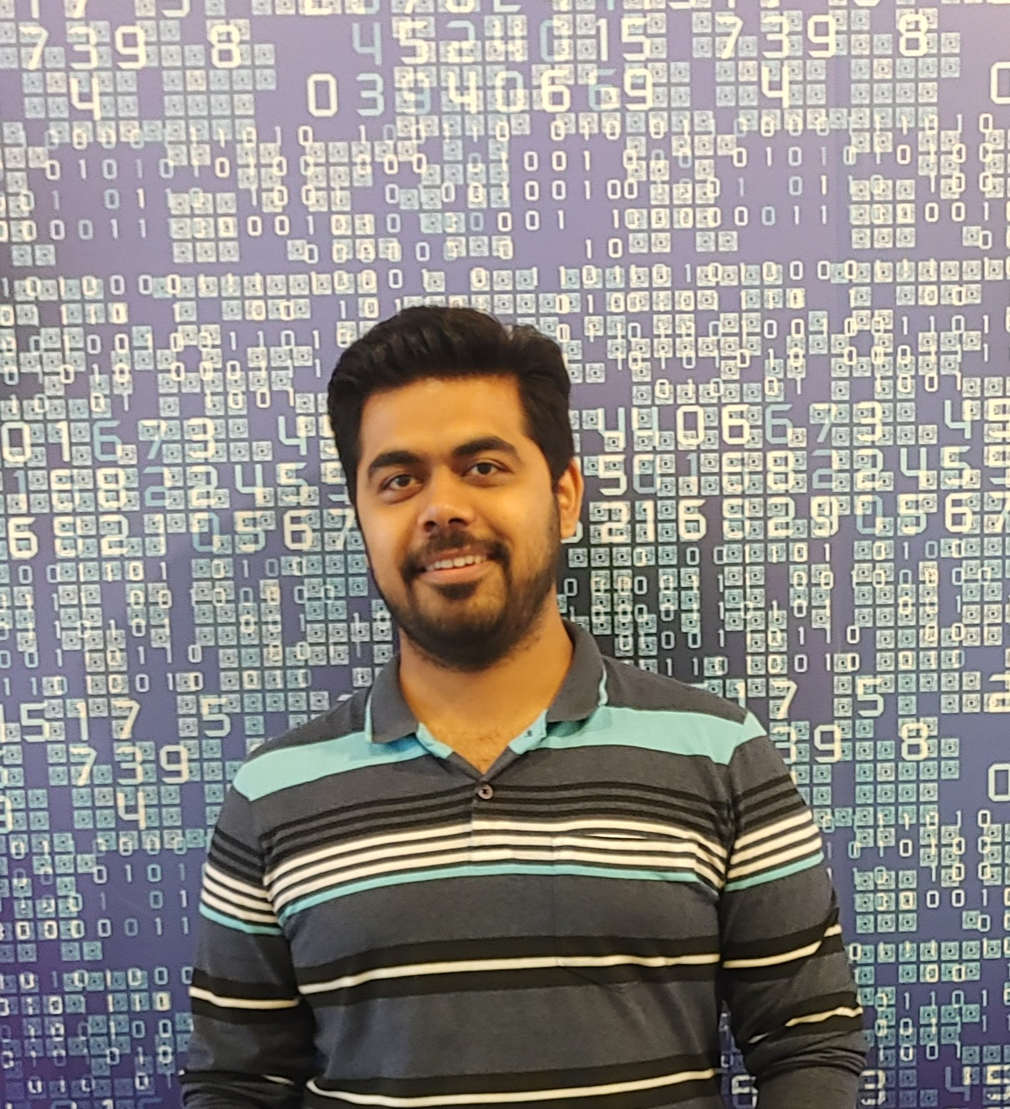
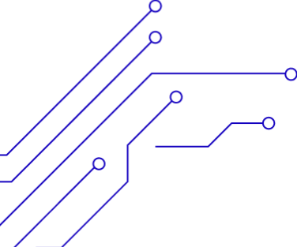
From API to On-Device: Building AI-Powered Story Generators with KMP and Gemma Models
Rivu Chakraborty
Mayur Madnani
A Practical Guide to Native & Smart Apps for multiple platforms

Slide 2
WHO AM I?
Staff Engg @ JioHotstar
Previously @ Intuit, Walmart, SAP
Expertise in Data, AI and Backend
~10 years in the Industry
GenAI Course Author
Mentor
Speaker

Slide 3
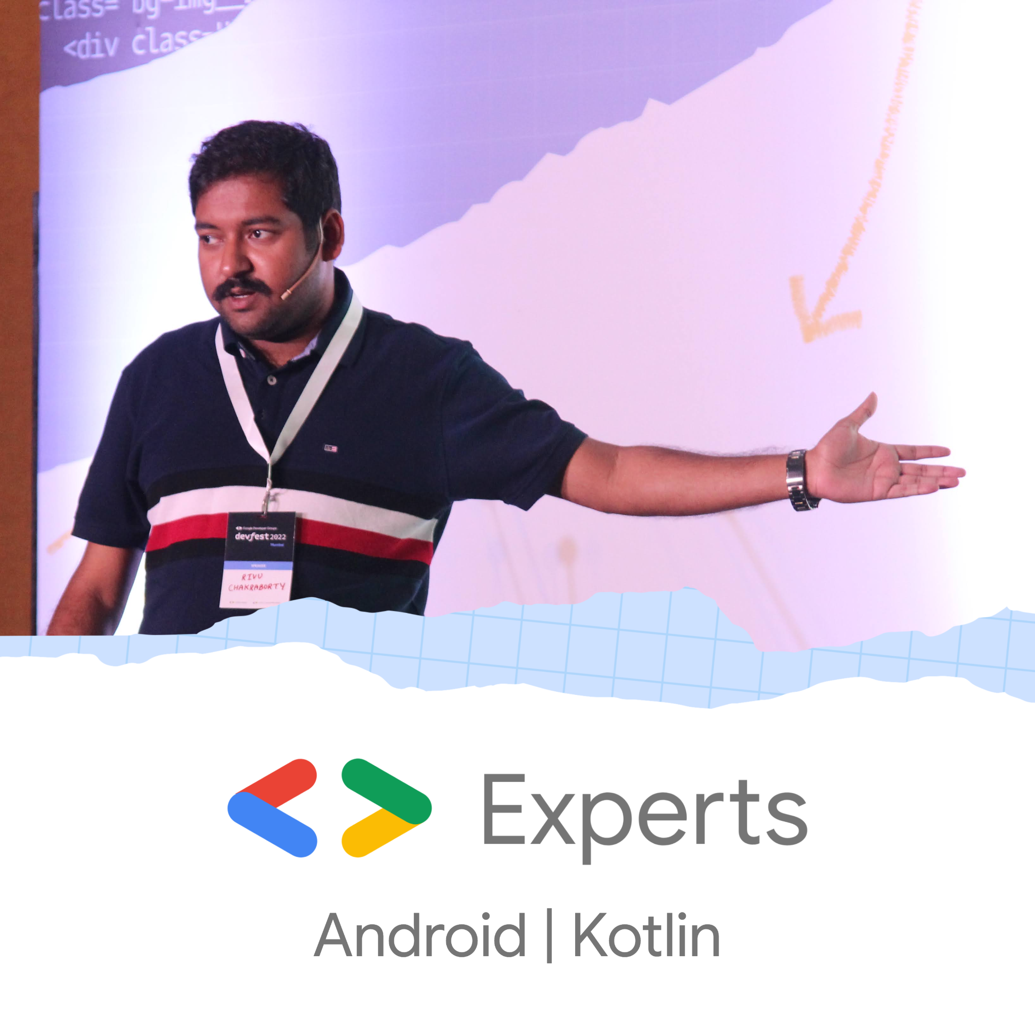

WHO AM I?
GDE (Google Developer Expert) for Android
Previously India’s first GDE for Kotlin
More than 14 years in the Industry
Founder @ Mobrio Studio
Previously
JioCinema/JioHotstar, Byju’s, Paytm, Gojek, Meesho
Author (wrote multiple Kotlin books)
Speaker
Mentor
Learning / Exploring ML/AI
Community Person (Started KotlinKolkata)
YouTuber (http://youtube.com/@RivuTalks)

Slide 4
Led personally by me (Rivu), with my decades of experience of scaling 6+ unicorn startups, and many smaller ones
We do Mobile Dev tooling (products) as well as we consult with product based startups, helping them develop or scale their apps
We can help with anything to do with mobile, starting from code quality, migration, refactor to feature development
At Mobrio Studio, I have a team, who work under my direct super vision.
We don’t just develop for you, we train your team, so you’re independent in future
https://mobrio.studio/

Slide 5
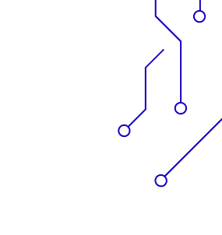

WHY THIS TALK?
GenAI is hot
Gemini API, Gemini Nano (Experimental) and Gemma models allow apps to use AI easily
KMP lets us build once for Android, iOS, Web & More
We'll walk through real code & gotchas

Slide 6
What’s KMP and Why?
A technology by JetBrains to share Kotlin code across platforms (Android, iOS, web, desktop, server).
Enables platform-specific UI while sharing core business logic (networking, database, state management). You control what you share and what you don’t
Write Once, Run Natively: Outputs native binaries (no VM or JS bridge).

Slide 7
What’s KMP and Why?
Incremental Adoption: Can be integrated into existing apps module by module, reducing migration risk.
Kotlin Ecosystem: Leverages the robust Kotlin ecosystem including Coroutines, Serialization, Ktor, SQLDelight, etc.

Slide 8

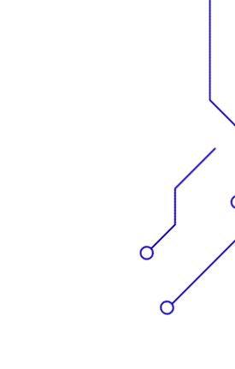
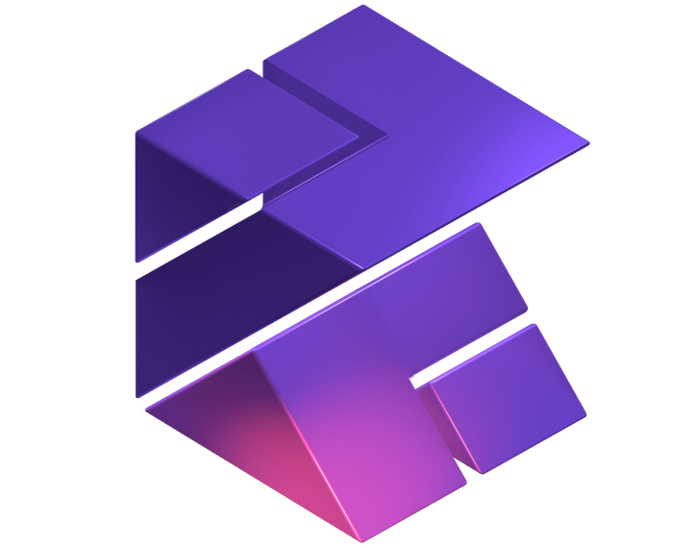
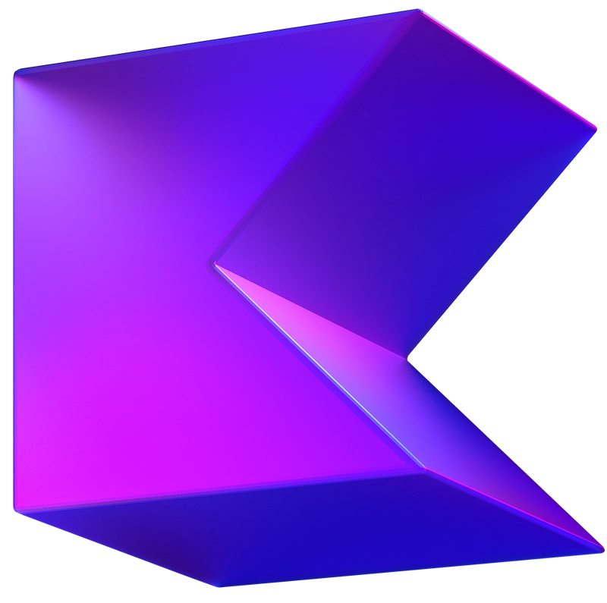
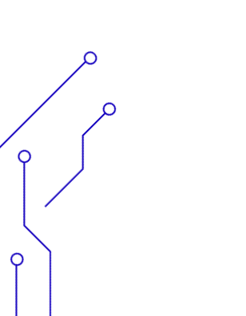

A Brief on KMP
Kotlin Multiplatform
Kotlin

Slide 9
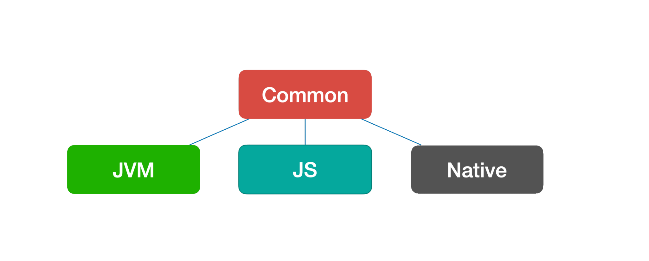
A Brief on KMP

Slide 10
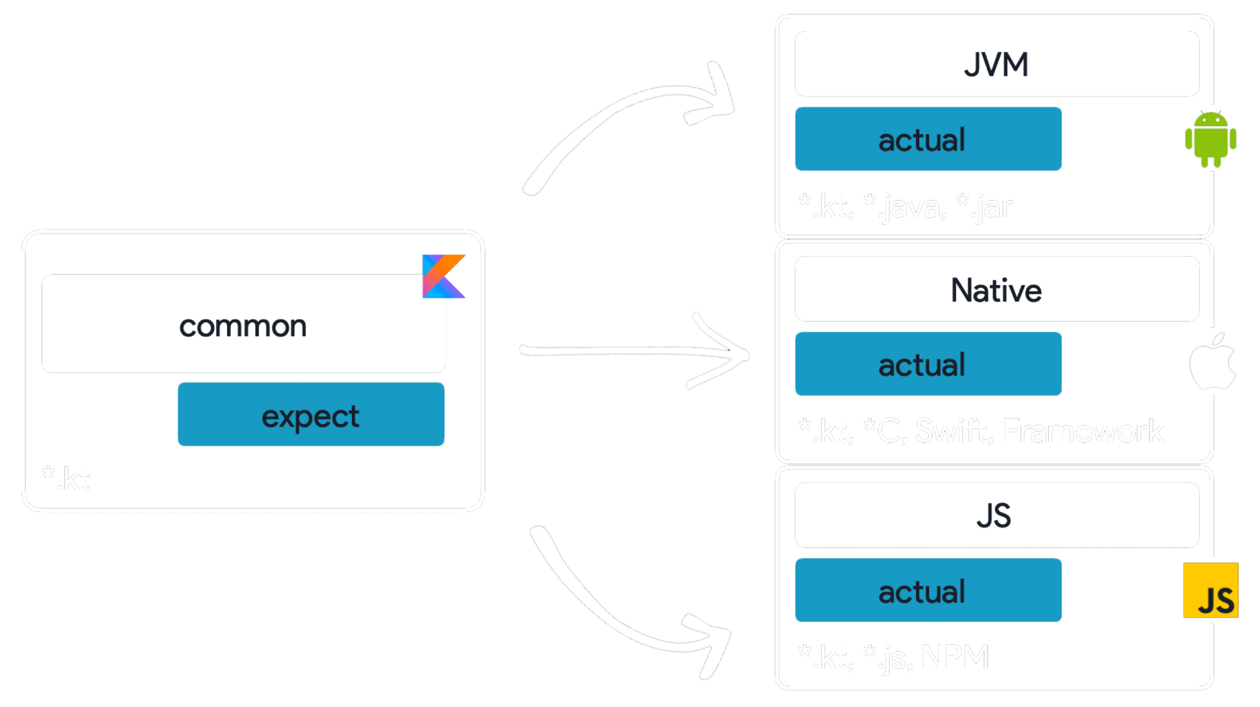
A Brief on KMP
actual fun doSomething() {
//Platform specific logic here
}
expect fun doSomething()

Slide 11
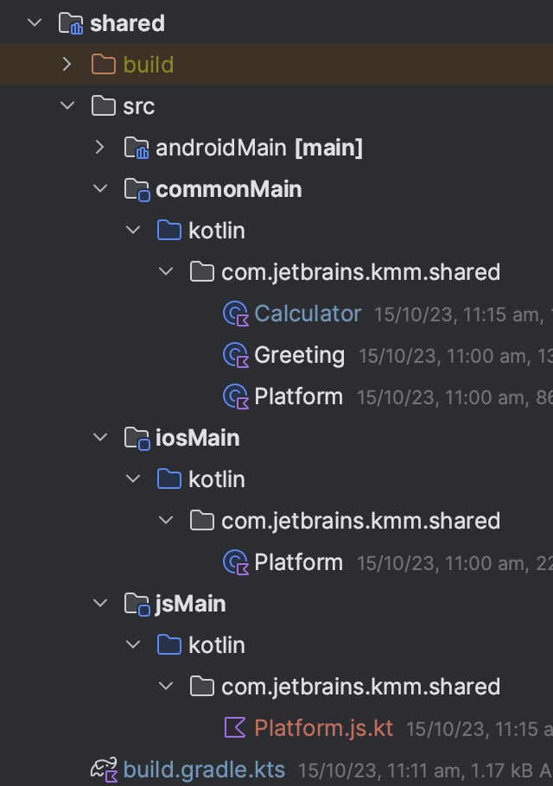
A Brief on KMP

Slide 12
What is GenAI in Mobile Development?
GenAI brings creative intelligence to mobile apps by enabling them to generate rather than just respond.
Enables hyper-personalized, intelligent, and context-aware user experiences.
Enhances accessibility, productivity, and entertainment within apps.
Can run on-device (for privacy/speed) or via cloud APIs.
In mobile apps, GenAI powers features like:
Text generation (e.g., storytelling, smart replies, chatbots)
Image generation/editing
Voice synthesis (TTS)

Slide 13
What’s AI?
Traditional Programming
Machine Learning
Input
ML Model Training
ML Model
Algorithm
Output
Input
Output
Run ML Inference
Input
Output
Developers write explicit algorithms that take input and produce a desired output.
Train the model with large dataset of input and output
Model is deployed on cloud/on-device to process input data i.e. inference

Slide 14
What’s GenAI?
Generative AI introduces the capability to understand inputs such as text, images, audio and video and generate human-like responses.
This enables applications like chatbots, language translation, text summarization, image captioning, image or code generation, creative writing assistance, and much more.
At its core, an LLM is a neural network model trained on massive amounts of text data. It learns patterns, grammar, and semantic relationships between words and phrases, enabling it to predict and generate text that mimics human language.

Slide 15
Why Gemini (by Google)?
Multimodal: Understands text, image, code, audio, and more.
Optimized for Android, iOS & Web
Enhances accessibility, productivity, and entertainment within apps.
Developer Friendly
Easy-to-use libraries / APIs
SDKs support prompting, streaming, and low-latency generation

Slide 16

Different Ways To Integrate Gemini in Mobile Apps
01
Gemini API
Either Directly with GeminiAPI or By Using The Third Party Library by Shreyas
02
Mediapipe / LLMInterference Library and Offline Model
Can be used with any tflite / LiteRT Models, not Gemma Specific
03
Gemini Nano
Currently Experimental, available only on Pixel 9 Devices
04
Firebase Vertex AI
You can use Gemini APIs and models with Firebase Vertex API, reducing the need for handling intricate details yourself

Slide 17
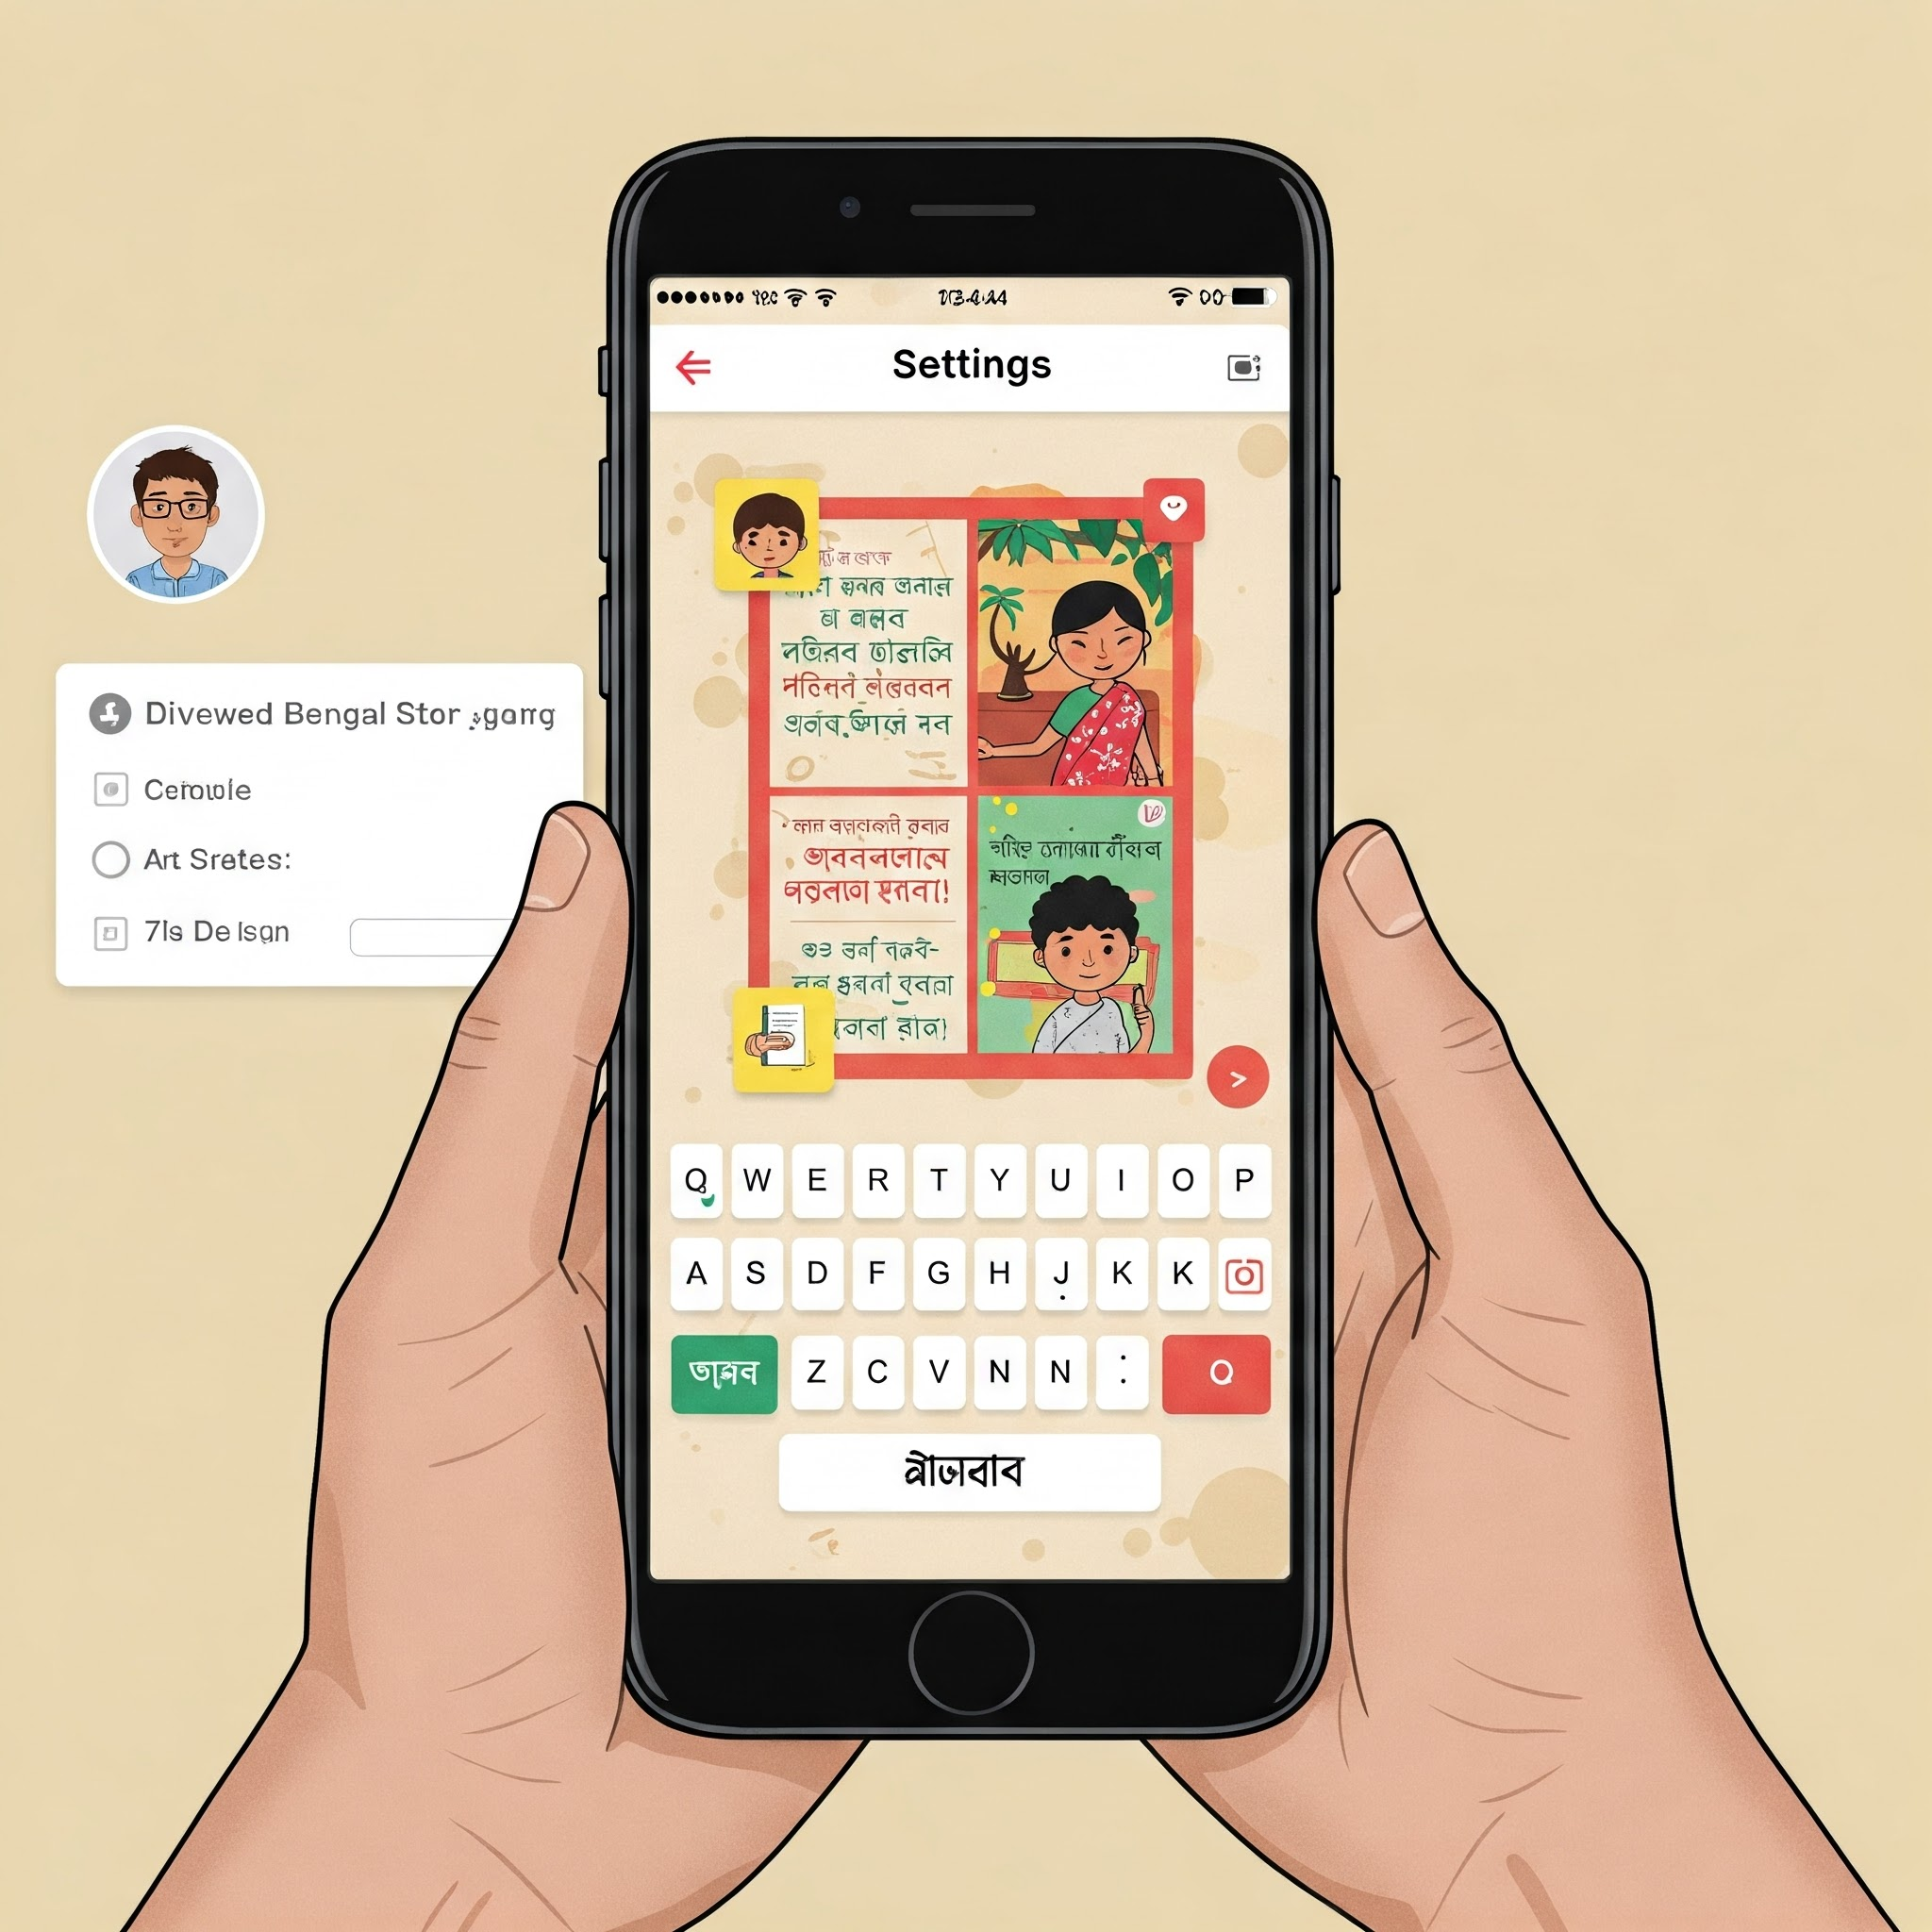







THE APP — GOLPOAI
Bengali word "Golpo" = Story
GOAL
Create an app that generates stories using GenAI
API
Use Gemini online API by default (Used Google Generative AI SDK for Kotlin Multiplatform by Shreyas Patil)
OFFLINE SUPPORT
Allow offline fallback with a local LLM (based off Gemma)
TECHNOLOGY
Built entirely with Kotlin Multiplatform + Compose

Slide 18
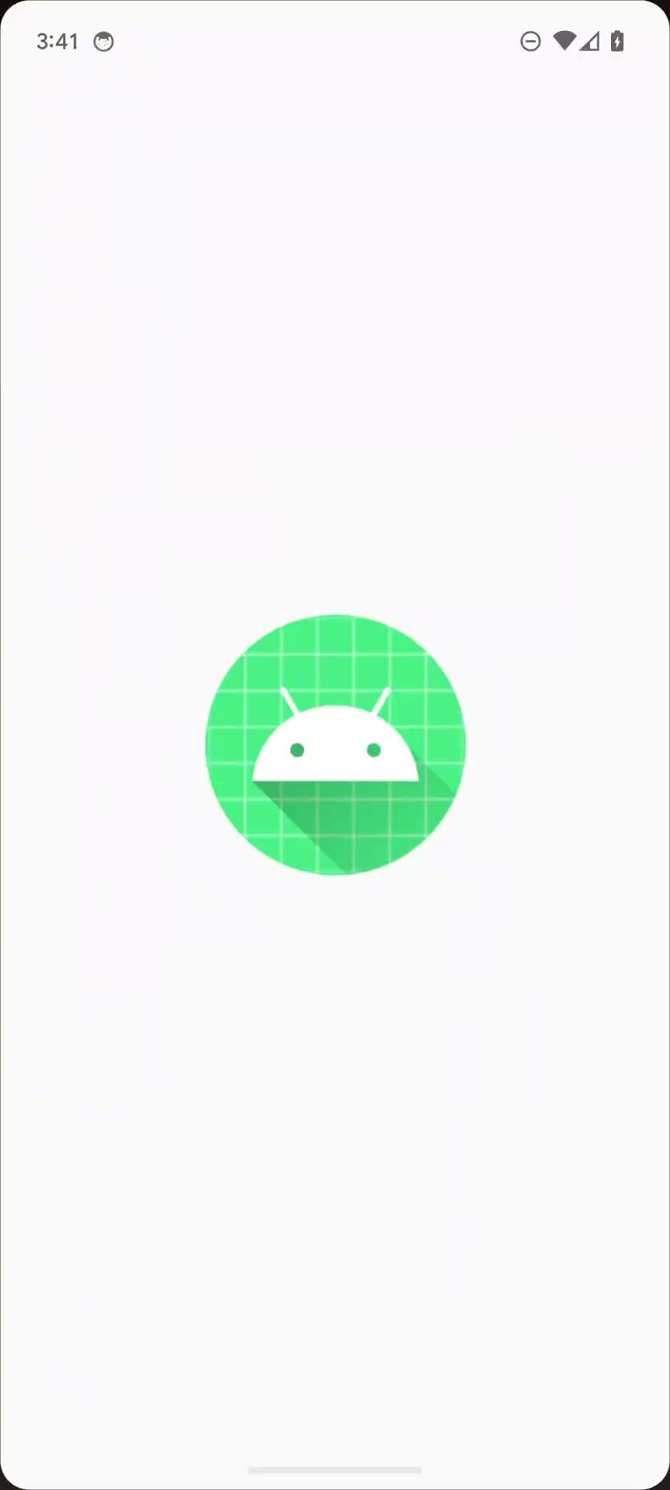
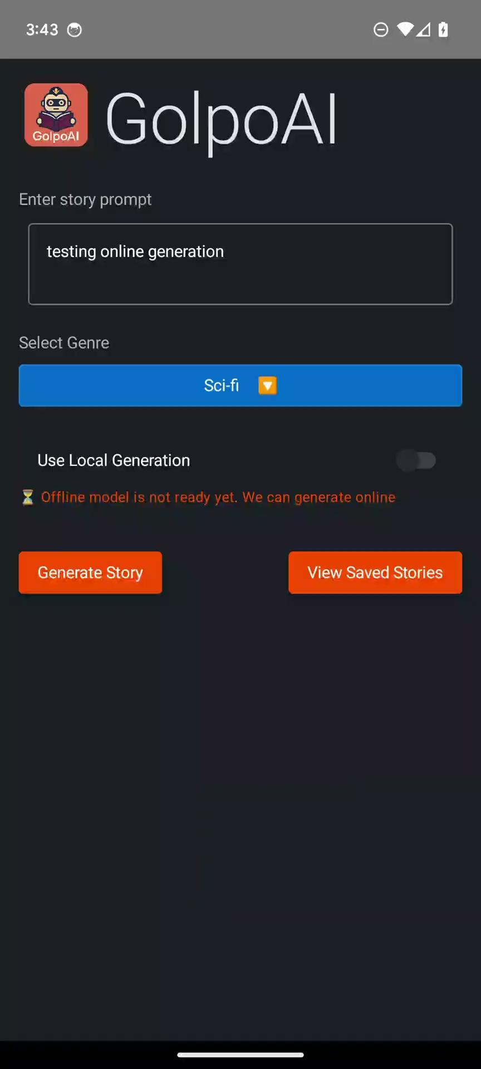
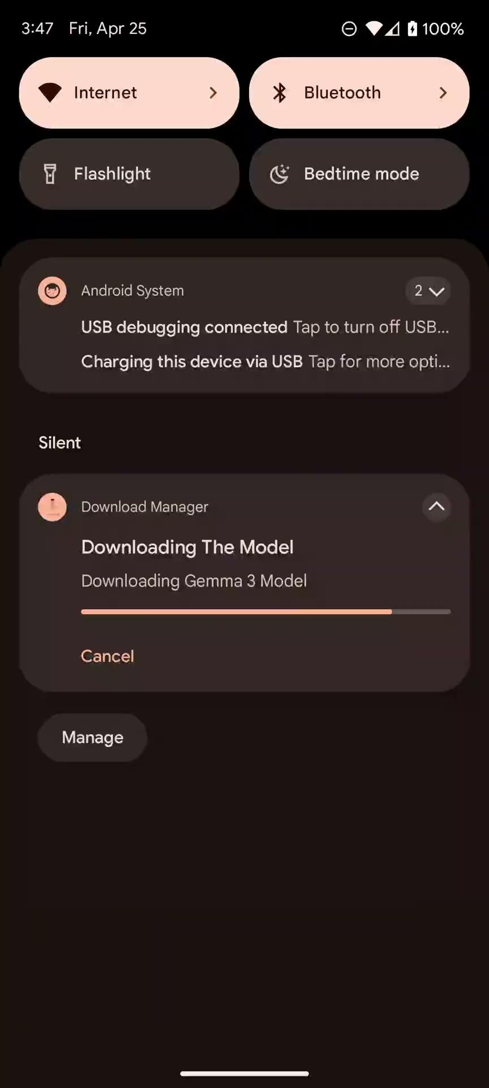
https://drive.google.com/drive/folders/1Z1zf-WhyobWK_YwXBW29jWEcJU7Sm23d
THE APP — GOLPOAI
Bengali word "Golpo" = Story

Slide 19
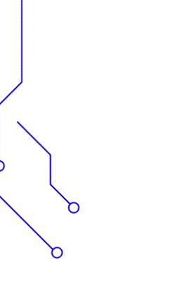

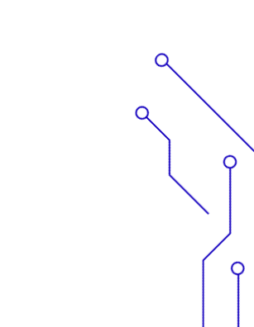

ARCHITECTURE OVERVIEW
composeApp/
UI & Presentation Layer
SHARED/
UseCases, Repositories, Models
GENAI/
Local GenAI LLM integrations
Clean Architecture

Slide 20
ARCHITECTURE OVERVIEW
Voyager
Navigation and ScreenModel
SQLDelight
DB for History
Gemini API via PatilShreyas / generative-ai-kmp, local Gemma3 model
USE KOIN FOR DI
RussWolf / Multiplatform Settings for Preferences

Slide 21
GENERATIVEMODEL INTERFACE
Shared contract for story generation
interface GenerativeModel {
suspend fun generateStory(prompt: String, awaitReadiness: Boolean = false): Result<String>
val isReady: StateFlow<Boolean>
}

Slide 22




GEMINI INTEGRATION (ONLINE)
Google Generative AI SDK for Kotlin Multiplatform by Shreyas Patil - https://github.com/PatilShreyas/generative-ai-kmp
API key stored in BuildKonfig
Suspend function for story generation
Works on Android & iOS

Slide 23
GENERATIVEMODEL IMPLEMENTATION (GEMINI)
class GenerativeModelGemini(private val apiKey: String) : GenerativeModel {
private val model by lazy {
GeminiApiGenerativeModel(
...
)
}
override suspend fun generateStory(prompt: String, awaitReadiness: Boolean): Result<String> {
return runCatching {
val input = content { text(prompt) }
val response = model.generateContent(input)
response.text ?: throw UnsupportedOperationException("No text returned from model")
}
}
}
commonMain.dependencies {
implementation("dev.shreyaspatil.generativeai:generativeai-google:<version>")
}
https://github.com/PatilShreyas/generative-ai-kmp

Slide 24
GENERATIVEMODEL IMPLEMENTATION (GEMINI)
GeminiApiGenerativeModel(
modelName = "gemini-2.0-flash",
apiKey = apiKey,
generationConfig = GenerationConfig.Builder().apply {
topK = 40
}
.build()
)
https://github.com/PatilShreyas/generative-ai-kmp

Slide 25
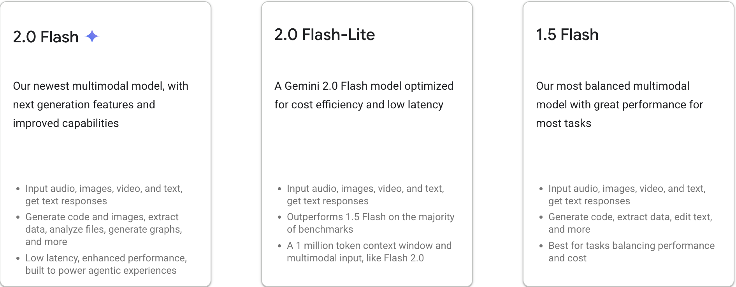
Gemini Models

Slide 26
OFFLINE MODE WITH GEMMA
01
USES MEDIAPIPE GENAI
02
TEXTGENERATOR EXPECT/ACTUAL
for platform-specific code
03
LOCALGENERATIVEMODEL
wraps the logic

Slide 27
MODEL DOWNLOAD & INITIALIZATION
DOWNLOAD .TASK FILE FROM SERVER
STORE IN INTERNAL APP DIRECTORY
INIT MEDIAPIPE LLM AFTER DOWNLOAD COMPLETES

Slide 28
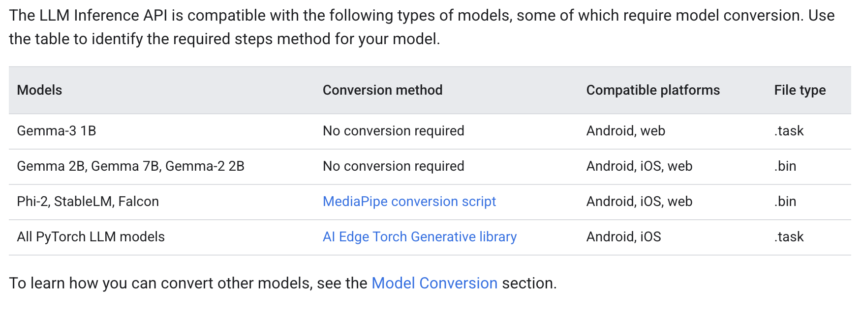
Gemma Models
That are supported by LLMInterference API
https://ai.google.dev/edge/mediapipe/solutions/genai/llm_inference

Slide 29
https://huggingface.co/google/gemma-3-1b-it
Download .task file and Store it in App Directory (Android Code)
val request = DownloadManager.Request(modelUrl.toUri())
.setNotificationVisibility(DownloadManager.Request.VISIBILITY_VISIBLE) // Visibility of the download Notification
.setDestinationUri(Uri.fromFile(modelFile)) // Uri of the destination file
.setDescription("Downloading Gemma 3 Model") // Title of the Download Notification
.setTitle("Downloading The Model") // Description of the Download Notification
.setRequiresCharging(false) // Set if charging is required to begin the download
.setAllowedOverMetered(true) // Set if download is allowed on Mobile network
.setAllowedOverRoaming(true) // Set if download is allowed on roaming network
val downloadManager = context.getSystemService(DOWNLOAD_SERVICE) as DownloadManager

Slide 30
Init MediaPipe LLM Interference
private val llmInference: LlmInference by lazy {
val options = LlmInference.LlmInferenceOptions.builder()
.setModelPath(modelFile.absolutePath)
.setMaxTokens(512)
.setMaxTopK(40)
.build()
LlmInference.createFromOptions(context, options)
}

Slide 31
Use The Model
actual suspend fun generate(prompt: String): String {
val result = withContext(Dispatchers.IO) {
llmInference.generateResponse(prompt)
}
return result ?: throw IllegalStateException("Model didn't generate")
}

Slide 32
Implement GenerativeModel interface
class LocalGenerativeModel(
private val textGenerator: TextGenerator
) : GenerativeModel {
override val isReady: StateFlow<Boolean> = textGenerator.isReady
override suspend fun generateStory(prompt: String, awaitReadiness: Boolean): Result<String> {
return runCatching {
if (!isReady.value && awaitReadiness) {
isReady.first { it }
}
textGenerator.generate(prompt)
}
}
}

Slide 33
Gemma 3 1b Local Generation

Slide 34
Generation Settings
GeminiApiGenerativeModel(
modelName = "gemini-2.0-flash",
apiKey = apiKey,
generationConfig = GenerationConfig.Builder().apply {
topK = 40
}
.build()
)
private val llmInference: LlmInference by lazy {
val options = LlmInference.LlmInferenceOptions.builder()
.setModelPath(modelFile.absolutePath)
.setMaxTokens(512)
.setMaxTopK(40)
.build()
LlmInference.createFromOptions(context, options)
}

Slide 35
TopK
Top-K filters tokens for output.
For example a Top-K of 3 keeps the three most probable tokens.
Increasing the Top-K value will increase the randomness of the model response.

Slide 36
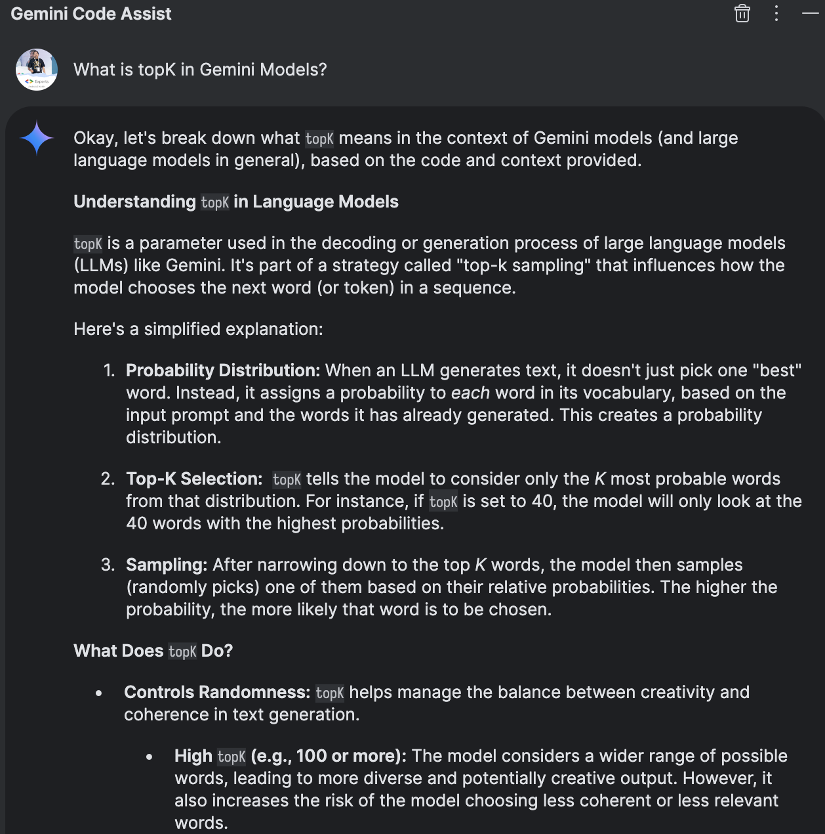
TopK
Top-K filters tokens for output.
For example a Top-K of 3 keeps the three most probable tokens.
Increasing the Top-K value will increase the randomness of the model response.

Slide 37
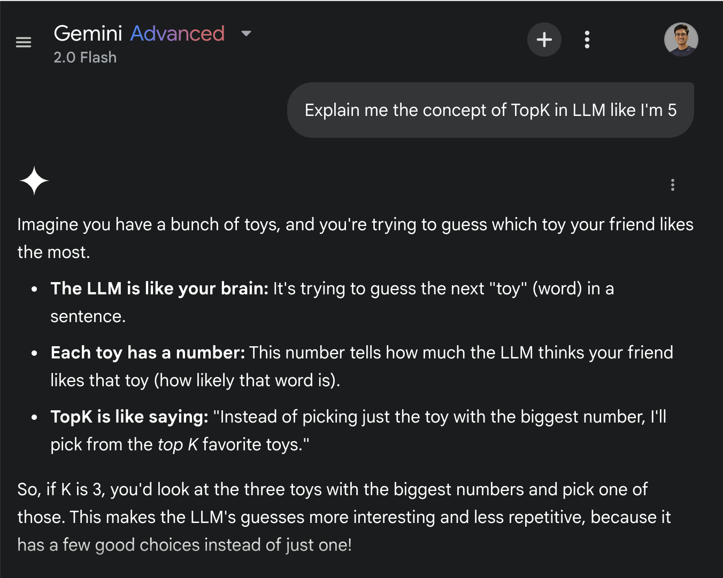
TopK
Top-K filters tokens for output.
For example a Top-K of 3 keeps the three most probable tokens.
Increasing the Top-K value will increase the randomness of the model response.

Slide 38
maxTokens
Limits the maximum output length a model can generate
A token can be a whole word, part of a word (like "ing" or "est"), punctuation, or even a space. The exact way text is tokenized depends on the specific model's tokenizer.
Whenever we call llmInference.generateResponse(prompt), the response generated by the local model will contain at most 512 tokens.

Slide 39
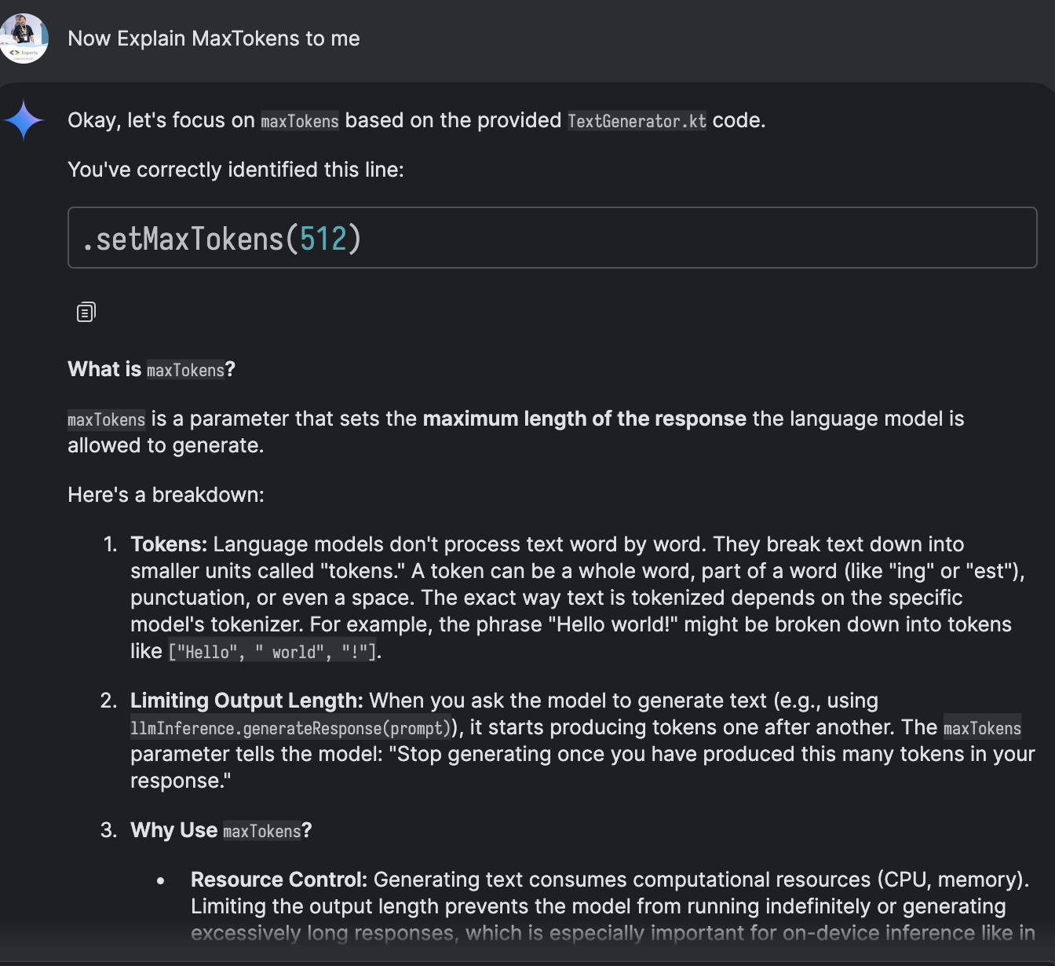
maxTokens
Limits the maximum output length a model can generate
A token can be a whole word, part of a word (like "ing" or "est"), punctuation, or even a space. The exact way text is tokenized depends on the specific model's tokenizer.
Whenever we call llmInference.generateResponse(prompt), the response generated by the local model will contain at most 512 tokens.

Slide 40





UI TOGGLE FOR OFFLINE MODE
Android-only toggle in HomeScreen
Uses russhwolf/multiplatform-settings
Persisted in SharedPreferences
Controls generateStory(..., offline = true)

Slide 41
Toggle in HomeScreen
if (getPlatform().platform == PlatformEnum.Android) {
LocalGenerationToggle(isEnabled = useLocal.value) {
screenModel.setUseLocalGeneration(it)
}
}
fun LocalGenerationToggle(
isEnabled: Boolean,
onToggle: (Boolean) -> Unit
) {
Row(
modifier = Modifier
.fillMaxWidth()
.padding(horizontal = 16.dp),
verticalAlignment = Alignment.CenterVertically,
) {
Text("Use Local Generation", modifier = Modifier.weight(1f))
Switch(checked = isEnabled, onCheckedChange = onToggle)
}
}

Slide 42
Multiplatform Settings
implementation("com.russhwolf:multiplatform-settings-no-arg:1.3.0")
fun setUseLocalGeneration(enabled: Boolean) {
screenModelScope.launch {
localGenerationSettings.useLocalGeneration = enabled
}
}
class LocalGenerationSettings(private val settings: Settings) {
...
var useLocalGeneration: Boolean
get() = settings.getBoolean(USE_LOCAL_GENERATION_KEY, false)
set(value) = settings.putBoolean(USE_LOCAL_GENERATION_KEY, value)
}
https://github.com/russhwolf/multiplatform-settings

Slide 43
Control Offline Generation
fun generateStory(prompt: String, genre: String, language: String) {
...
val isOffline = useLocalGeneration.value
screenModelScope.launch {
try {
val story = useCase.generateStory(
prompt = prompt,
genre = genre,
language = language,
offline = isOffline
)
...
} catch (e: Exception) {
...
}
}
}

Slide 44
Control Offline Generation
suspend fun generateStory(prompt: String, offline: Boolean): Result<String> {
val model = if (offline) offlineModel else onlineModel
return model.generateStory(prompt)
}

Slide 45



REPOSITORY LOGIC
GENERATE STORY(PROMPT, OFFLINE)
uses selected model
REPOSITORY HOLDS BOTH ONLINE & OFFLINE MODELS
REPOSITORY/USECASE RELAYS READINESS STATUS TO UI

Slide 46
Full Repository Code
class StoryRepository(
private val onlineModel: GenerativeModel,
private val offlineModel: GenerativeModel
) {
val isOfflineModelReady: StateFlow<Boolean> = offlineModel.isReady
suspend fun generateStory(prompt: String, offline: Boolean): Result<String> {
val model = if (offline) offlineModel else onlineModel
return model.generateStory(prompt)
}
}

Slide 47
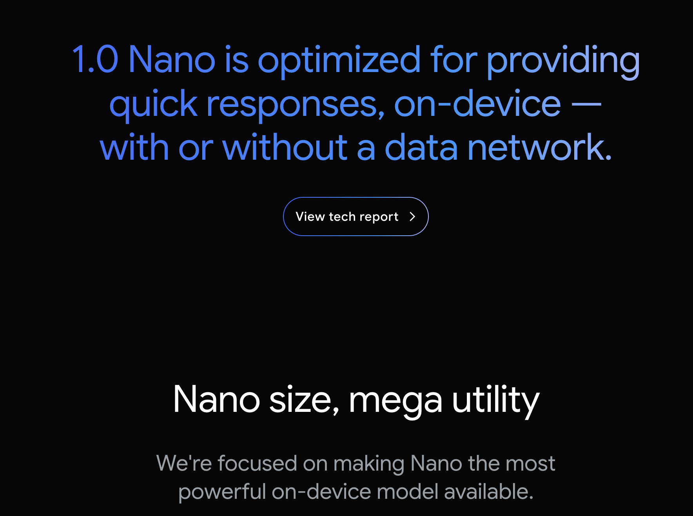
Gemini Nano

Slide 48
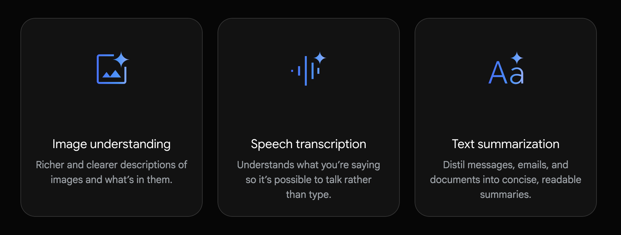
Gemini Nano

Slide 49
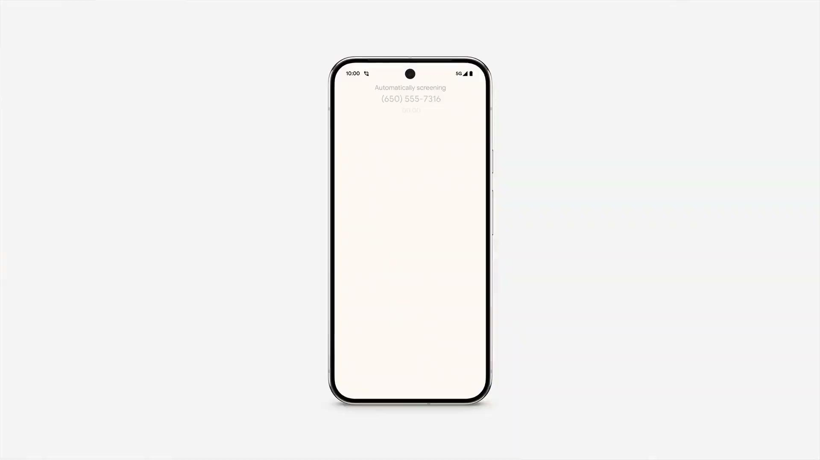
Gemini Nano
Source: https://deepmind.google/technologies/gemini/nano/

Slide 50
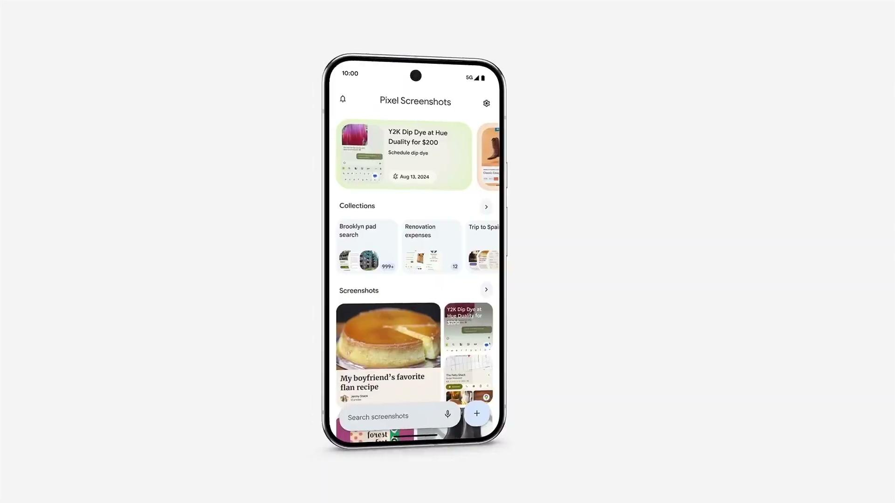
Gemini Nano
Source: https://deepmind.google/technologies/gemini/nano/

Slide 51
Integrate Gemini Nano
implementation("com.google.ai.edge.aicore:aicore:0.0.1-exp01")

Slide 52
Integrate Gemini Nano
val generationConfig = generationConfig {
context = ApplicationProvider.getApplicationContext()
temperature = 0.2f
topK = 16
maxOutputTokens = 256
}
//Pass it through DI

Slide 53
Integrate Gemini Nano
val generativeModel = GenerativeModel(
generationConfig = generationConfig,//Through DI
)

Slide 54
Integrate Gemini Nano
override suspend fun generateStory(prompt: String, awaitReadiness: Boolean): Result<String> {
return runCatching {
val input = content { text(prompt) }
val response = generativeModel.generateContent(input)
response.text ?: throw UnsupportedOperationException("No text returned from model")
}
}

Slide 55
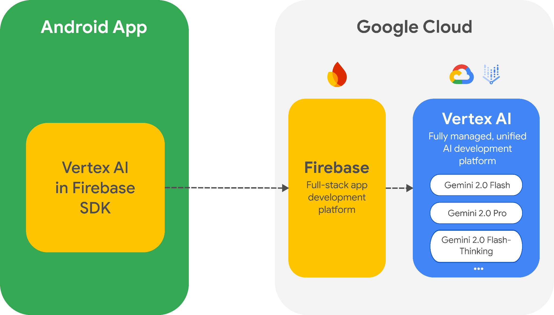
Vertex AI
Google Recommends using Vertex AI in Firebase SDK for Android to access the Gemini API and the Gemini family of models directly from the app.

Slide 56
Vertex AI
implementation("com.google.firebase:firebase-vertexai:$version")
class GenerativeModelVertex() : GenerativeModel {
val generativeModel = Firebase.vertexAI.generativeModel("gemini-2.0-flash")
override suspend fun generateStory(prompt: String, awaitReadiness: Boolean): Result<String> {
return runCatching {
model.generateContent(prompt)
}
}
}

Slide 57

Large Language Models (LLMs)
Massive Scale
Deep Architecture
Versatile Performance
Resource Intensive
Hundreds of billions to trillions of parameters trained on vast internet datasets, books, and diverse text corpora.
Multi-layer transformer networks with extensive attention mechanisms for human-like text generation.
The "Swiss Army knife" of AI—excels at general-purpose tasks from content creation to complex reasoning.
Demands high-end GPUs/TPUs with substantial operational costs and environmental impact.

Slide 58

Small Language Models (SLMs)
Compact Architecture
Precision-Focused
Agentic Future
Knowledge Transfer
Lightweight models with parameters ranging from millions to under 7 billion—optimized for efficiency.
The "scalpel" of AI—specialized for narrowly-defined tasks on mobile and edge devices.
Growing consensus: SLMs power repetitive, specialized agentic systems more economically than LLMs.
Often derived from larger models, retaining strong linguistic capabilities with minimal footprint.

Slide 59









SLM Offerings

Slide 60
Gemma models Deeper Dive
Gemma is Google's family of open, lightweight models built from the same research powering Gemini—delivering enterprise-grade performance with efficiency.
Decoder-Only Transformer
Streamlined architecture for efficient text generation
Advanced Attention
Multi-Head/Multi-Query mechanisms for efficiency
Shared Embeddings
RoPE and GeGLU activations for position encoding
Vision-Language
Multimodal capability for processing text and visuals
MatFormer Innovation
Matryoshka Representation learning

Slide 61

Model Adaptation Imperative
Domain Mismatch
Generic models struggle in specialized fields—finance, healthcare, niche coding languages.
Static Knowledge
Pre-trained models lack evolving information and real-time context.
Deployment Constraints
Large model size makes industry deployment costly and impractical.

Slide 62
Adaptation Techniques
Parametric Knowledge Adaptation
Updates model's weights.
DAPT: Domain-Adaptive Pre-Training
SFT: Supervised Fine-Tuning
PEFT (LoRA): Parameter-Efficient Fine-Tuning
Ideal for: Efficient domain shift (healthcare chatbots, financial analysis)
Semi-Parametric Knowledge Adaptation
Leverage external knowledge sources.
RAG: Retrieval-Augmented Generation
Agent-Based Systems: Dynamic tool integration
Ideal for: Real-time knowledge integration (dynamic APIs, live data)

Slide 63
Prompt Engineering Strategies
Few-Shot Prompting
Provide targeted examples within the prompt to guide model behavior and task execution.
Chain-of-Thought (CoT)
Instruct models to "think step-by-step" for improved reasoning on complex, multi-stage problems.
Prompt engineering transforms model behavior without changing weights—maximizing value from pre-trained models through strategic input design

Slide 64
LoRA: Low-Rank Adaptation
Supervised Fine-Tuning (SFT)
Adapts pre-trained models to specialized tasks using labeled instruction-response pairs.
Freezes original model weights, injects small trainable low-rank matrices into transformer layers.
Extreme Efficiency
Fine-tune large models on consumer or single GPU.
Modular Portability
Maintain multiple lightweight LoRA adapters.

Slide 65
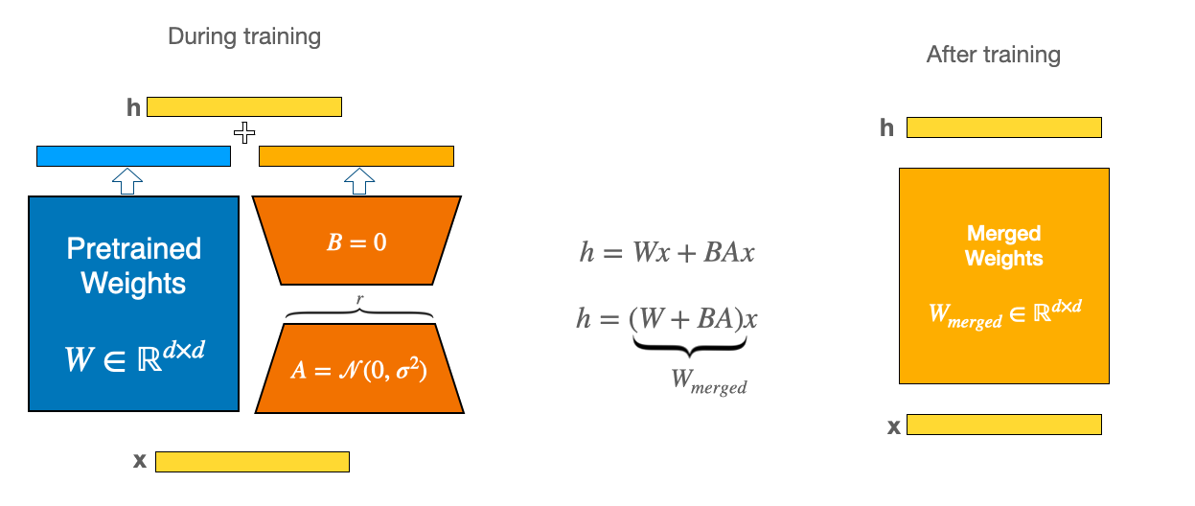
LoRA: Low-Rank Adaptation

Slide 66
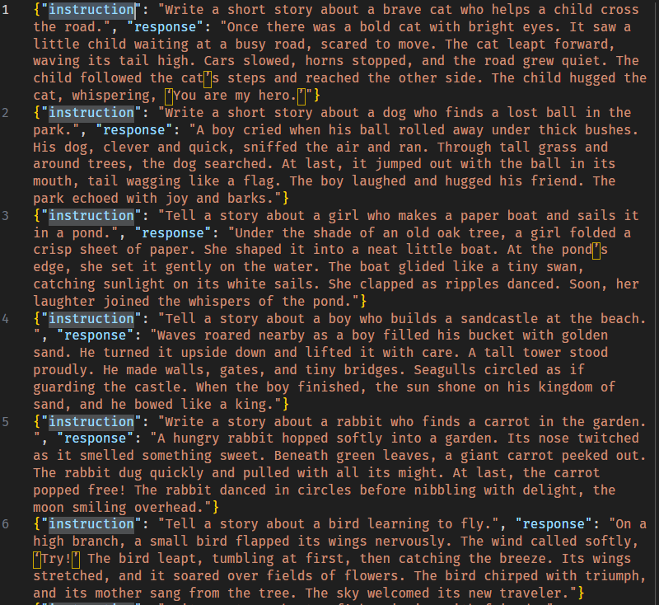
Dataset

Slide 67
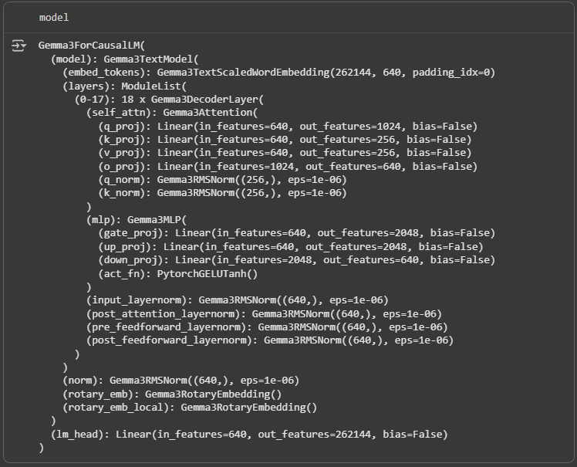
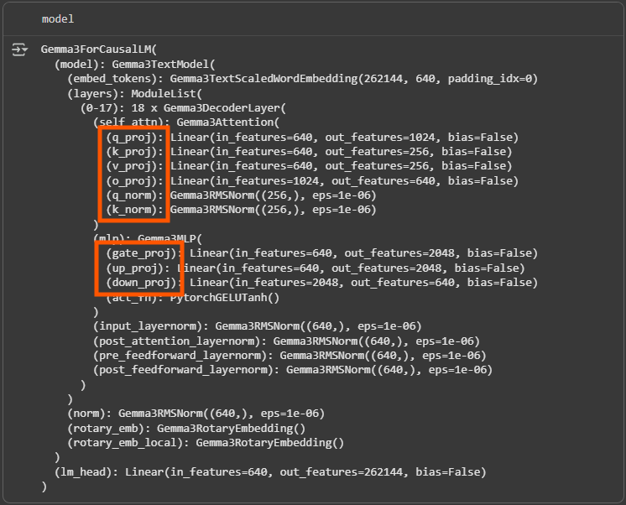
Base
Model

Slide 68
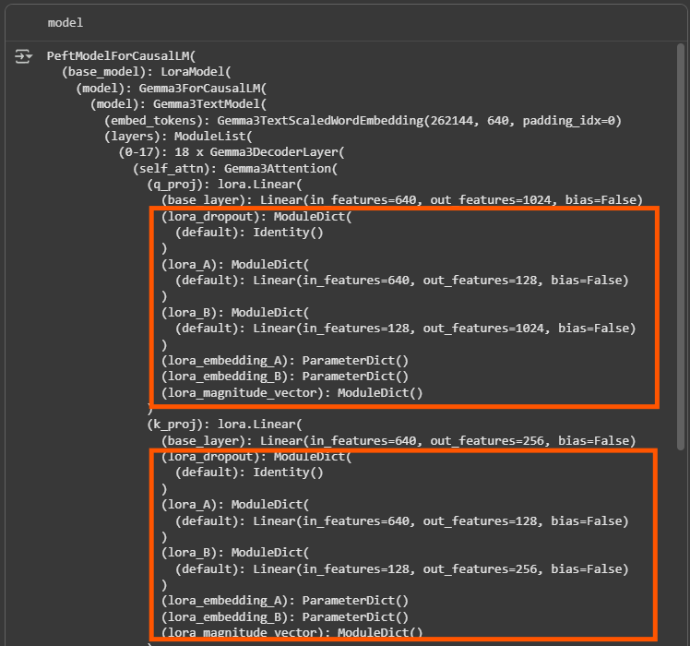
LoRA
Model
(PEFT)

Slide 69
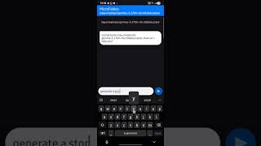
Demo: https://youtube.com/shorts/xvgemTvzmOk
THE Demo App — MicroFables

Slide 70
Conclusion
SLM Advantage
Models like Gemma deliver lower deployment costs, faster inference, and practical industry benefits over LLMs.
Open-Source Foundation
Gemma provides efficient, Google-backed baselines for enterprise fine-tuning and specialized applications.
Balanced Adaptation
Techniques like prompt tuning and LoRA optimize the efficiency-effectiveness trade-off for resource-constrained deployments.

Slide 71
Integrate to Android Through Ollama
@Serializable
data class OllamaRequest(
val model: String,
val prompt: String,
val stream: Boolean = false
)

Slide 72
Integrate to Android Through Ollama
suspend fun generateResponse(request: OllamaRequest): Result<OllamaResponse> {
return try {
val response = httpClient.post("$baseUrl/api/generate") {
contentType(ContentType.Application.Json)
setBody(request)
}
if (response.status.isSuccess()) {
Result.success(response.body<OllamaResponse>())
} else {
Result.failure(Exception("HTTP ${response.status.value}: ${response.status.description}"))
}
} catch (e: Exception) {
Result.failure(e)
}
}

Slide 73
Integrate to Android Through Ollama
override suspend fun generateStory(prompt: String, awaitReadiness: Boolean): Result<String> {
return try {
...
val result = apiService.generateResponse(request)
...
} catch (e: Exception) {
Result.failure(e)
}
}

Slide 74
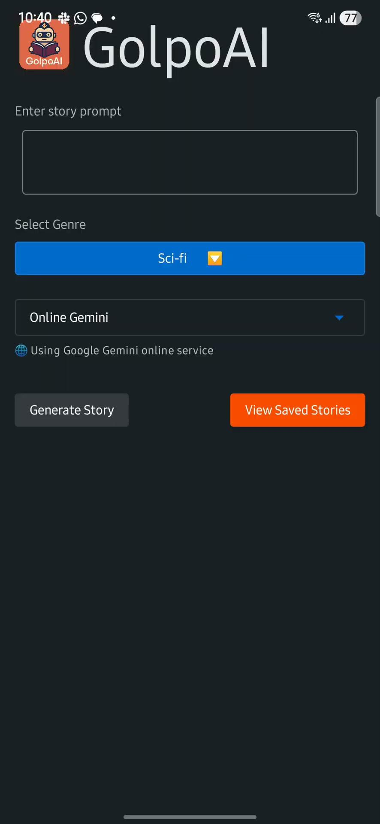
https://drive.google.com/drive/folders/1Z1zf-WhyobWK_YwXBW29jWEcJU7Sm23d
THE Finetuned GolpoAI App

Slide 75
CHALLENGES FACED
COCOAPODS INTEGRATION FOR IOS
Cocoapods integration for iOS caused issues, still fixing it 😜
MEDIAPIPE GENAI
MediaPipe GenAI supports Android, iOS and Web, however integrating it with KMP is challenging

Slide 76
KEY TAKEAWAYS
It’s easy to integrate GenAI with your KMP apps
Vertex AI makes it even easier
LLM Interference / MediaPipe works but its’ not for most of the usecases
Gemini Nano can be a game changer
Code reusability across platforms with KMP

Slide 77
KEY TAKEAWAYS
https://github.com/RivuChk/GolpoAI
This project was written using AI Code Generation
With architectural guidance and fixes and making stuff right by me 😜

Slide 78
RESOURCES
https://speakerdeck.com/rivuchk/from-api-to-on-device-building-ai-powered-story-generators-with-kmp-and-gemma-models
https://github.com/RivuChk/GolpoAI
https://github.com/PatilShreyas/generative-ai-kmp
https://github.com/mayurmadnani/MicroFables
https://huggingface.co/mayurmadnani/gemma-3-270m-microfables
https://ollama.com/mayurmadnani/gemma-3-270m-microfables

Slide 79
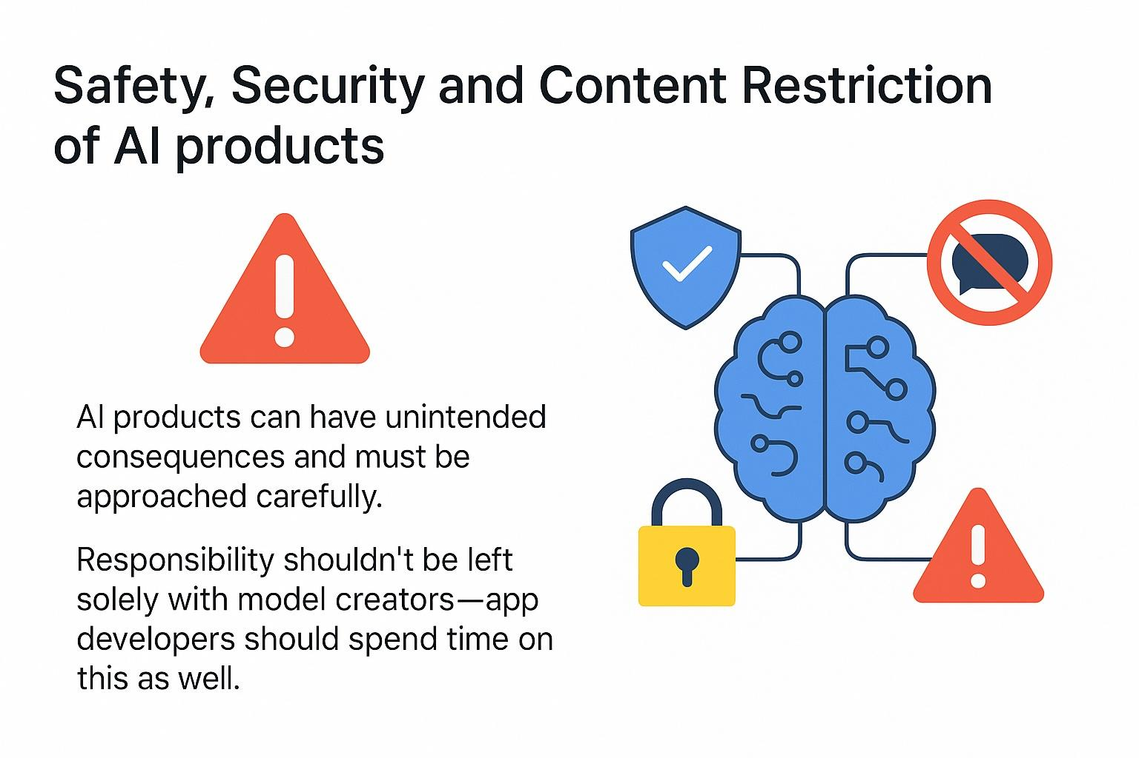
PAUSE &
THINK

Slide 80



THANK YOU
🌐 https://www.rivu.dev/
🌐 linkedin.com/in/mayurmadnani/
youtube.com/@rivutalks
@rivuchakraborty

